Slide 1
Greedy Algorithm
Solves an optimization problem. For many optimization problems, greedy algorithm can be used. (not always)
Greedy algorithm for optimization problems typically go through a sequence of steps, with a set of choices at each step. Current choice does not depend on evaluating potential future choices or pre-solving repeatedly occurring subproblems (a.k.a., overlapping subproblems). With each step, the original problem is reduced to a smaller problem.
Greedy algorithm always makes the choice that looks best at the moment.
It makes a locally optimal choice in the hope that this choice will lead to a globally optimal solution.

Slide 2
Optimal Solution
What is an Optimal Solution?
Given a problem, more than one solution exist
One of the solution is the best based on some given constraints, that solution is called the optimal solution
What is Global Optimal Solution?
Optimal Solution to the main problem
What is local Optimal Solution?
Optimal Solution to the sub-problems

Slide 3
Example of Greedy Algorithms
Activity Selection Problem
Coin Changing Problem
Job Scheduling Problem
Fractional Knapsack Problem
Dijkstra’s Shortest Path Problem
Minimum Spanning Tree Problem

Slide 4
Greedy algorithms
Make choices one-at-a-time.
Never look back.
Hope for the best.

Slide 5
Item:
Weight:
6
2
4
3
11
Capacity: 10
Value:
20
8
14
13
35
3.33
4
3.5
4.33
3.18

Slide 6
Item:
Weight:
6
2
4
3
11
Capacity: 10
Value:
20
8
14
13
35
3.33
4
3.5
4.33
3.18
Unbounded Knapsack:
Suppose I have infinite copies of all items.
“Greedy” algorithm for unbounded knapsack with fraction:
Tacos have the best Value/Weight ratio!
Keep grabbing tacos!
Total weight: 10
Total value: 43.333
6

Slide 7
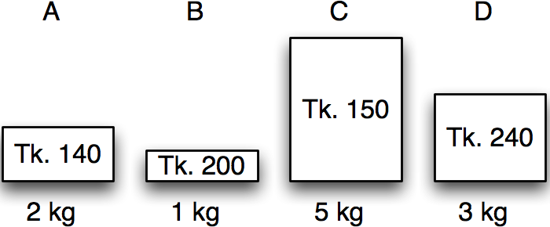
Greedy algorithms
Fractional knapsack in action
Item | Benefit | Weight
A | 140 | 2 kg
B | 200 | 1 kg
C | 150 | 5 kg
D | 240 | 3 kg
Calculate benefit/kg – the value index.

Slide 8
Greedy algorithms
Fractional knapsack in action
Item | Benefit | Weight | Value index
A | 140 | 2 kg | 70
B | 200 | 1 kg | 200
C | 150 | 5 kg | 30
D | 240 | 3 kg | 80
Sort by non-increasing value index.
Licensed under
30 / 38

Slide 9
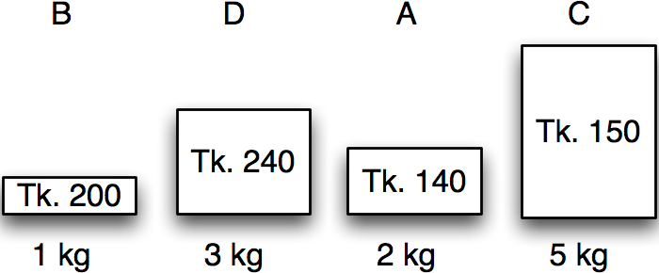
Greedy algorithms
Fractional knapsack in action
Item | Benefit | Weight | Value index
B | 200 | 1 kg | 200
D | 240 | 3 kg | 80
A | 140 | 2 kg | 70
C | 150 | 5 kg | 30
Maximum weight:
5 kg
30 / 38

Slide 10
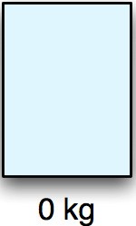
Greedy algorithms
Fractional knapsack in action
Item | Benefit | Weight | Value index | Chosen
B | 200 | 1 kg | 200 | 0 kg
D | 240 | 3 kg | 80 | 0 kg
A | 140 | 2 kg | 70 | 0 kg
C | 150 | 5 kg | 30 | 0 kg
Maximum weight:
5 kg
Remaining:
5 kg
Benefit:
0 kg
30 / 38

Slide 11
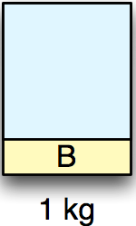
Greedy algorithms
Fractional knapsack in action
Item | Benefit | Weight | Value index | Chosen
B | 200 | 1 kg | 200 | 1 kg
D | 240 | 3 kg | 80 | 0 kg
A | 140 | 2 kg | 70 | 0 kg
C | 150 | 5 kg | 30 | 0 kg
Maximum weight:
5 kg
Remaining:
4 kg
Benefit:
200 tk
30 / 38

Slide 12
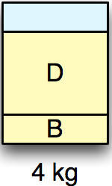
Greedy algorithms
Fractional knapsack in action
Item | Benefit | Weight | Value index | Chosen
B | 200 | 1 kg | 200 | 1 kg
D | 240 | 3 kg | 80 | 3 kg
A | 140 | 2 kg | 70 | 0 kg
C | 150 | 5 kg | 30 | 0 kg
Maximum weight:
5 kg
Remaining:
1 kg
Benefit:
440 tk
30 / 38

Slide 13
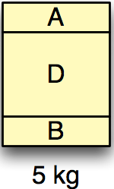
Greedy algorithms
Fractional knapsack in action
Item | Benefit | Weight | Value index | Chosen
B | 200 | 1 kg | 200 | 1 kg
D | 240 | 3 kg | 80 | 3 kg
A | 140 | 2 kg | 70 | 1 kg
C | 150 | 5 kg | 30 | 0 kg
Maximum weight:
5 kg
Remaining:
0 kg
Benefit:
510 tk
30 / 38

Slide 14
Greedy algorithms
Fractional knapsack in action
Item | Benefit | Weight | Value index | Chosen
B | 200 | 1 kg | 200 | 1 kg
D | 240 | 3 kg | 80 | 3 kg
A | 140 | 2 kg | 70 | 1 kg
C | 150 | 5 kg | 30 | 0 kg
Maximum weight:
5 kg
Remaining:
0 kg
Benefit:
510 tk
30 / 38

Slide 15
Exercise
Assume that we have a knapsack with max weight capacity, W = 16. our objective is to fill the knapsack with items such that the benefit (value or profit) is maximum. Consider the following items and their associated weight and value
ITEM | WEIGHT | VALUE
i1 | 6 | 6
i2 | 10 | 2
i3 | 3 | 1
i4 | 5 | 8
i5 | 1 | 3
i6 | 3 | 5

Slide 16
Activity-Selection Problem
Problem: get your money’s worth out of a festival
Buy a wristband that lets you onto any ride
Lots of rides, each starting and ending at different times
Your goal: ride as many rides as possible
Another, alternative goal that we don’t solve here: maximize time spent on rides
Welcome to the activity selection problem

Slide 17
CS 161 Class
Math 51 Class
CS 161 Section
Sleep
Frisbee Practice
You can only do one activity at a time, and you want to maximize the number of activities that you do.
What to choose?
CS 161 Office Hours
Theory Seminar
Orchestra
Programming team meeting
CS 166 Class
Underwater basket weaving class
CS110 Class
CS161 study group
Swimming lessons
Theory Lunch
Combinatorics Seminar
Social activity
time

Slide 18
Activity selection
a_{i}
Input:
Activities a₁, a₂, …, a_{n}
Start times s₁, s₂, …, s_{n}
Finish times f₁, f₂, …, f_{n}
Output:
A way to maximize the number of activities you can do today.
s_{i}
f_{i}
time
In what order should you greedily add activities?
Think-share!
1 minute think; (wait) 1 minute share

Slide 19
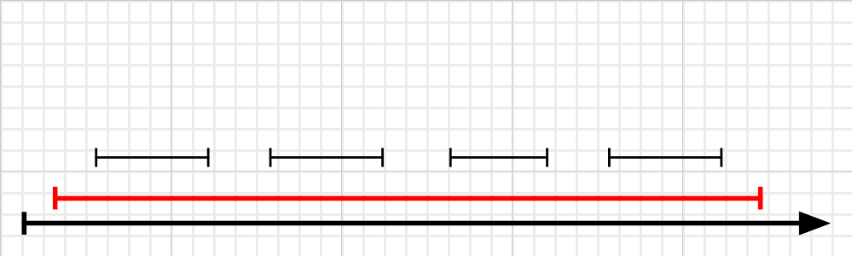
Strategy 1:tegy 1. Earliest First
The idea is to start using the resource as early as possible.
1. Sort the activities by starting time, breaking ties arbitrarily.
2. Pick the first one, removing it from the list along with all the activities that conflict with it.
3. Repeat Step 2, until the list is empty.
Number Of Activity = 1
This strategy does not lead to an optimal solution.

Slide 20
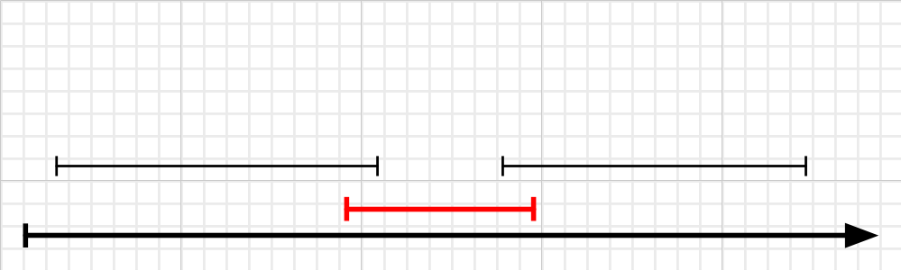
Strategy 2:tegy 1. Earliest First
The idea is to start shortest activity.
1. Sort the activities by length, breaking ties arbitrarily.
2. Pick the first one, removing it from the list along with all the activities that conflict with it.
Repeat Step 2, until the list is empty.
Number Of Activity = 1
This strategy does not lead to an optimal solution.

Slide 21
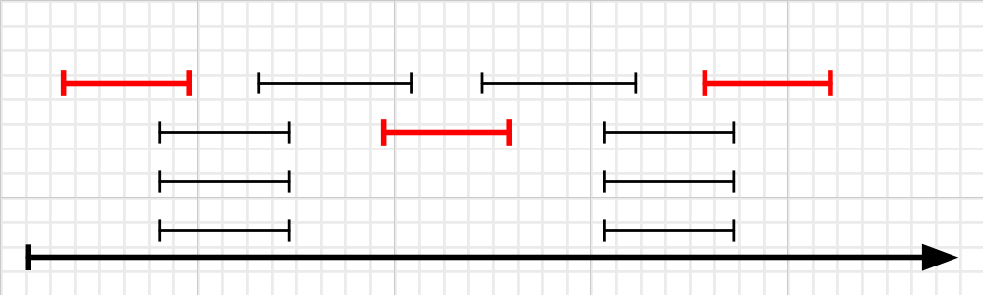
Strategy 3:tegy 1. Earliest First
The idea is to start with least-conflict activity.
Strategy 3. Least-conflict First
The Shortest First strategy failed perhaps because the shorter ones had more conflicts, and ruled out too many activities in the process.
1. Sort the activities by the number of other activities which conflict with it.
2. Pick the first one, removing it from the list along with all the activities that conflict with it.
3. Repeat Step 2, until the list is empty.
This strategy does not lead to an optimal solution.

Slide 22
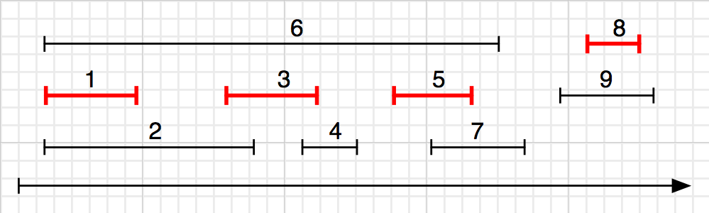
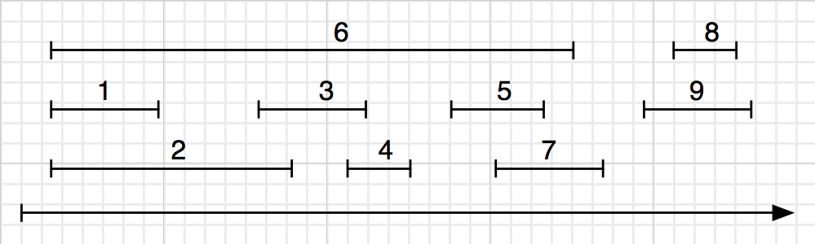
Strategy 4:tegy 1. Earliest First
The idea is to start with finish-first activity.
1. Sort the activities by finishing time, breaking ties arbitally.
2. Pick the first one, removing it from the list along with all the activities that conflict with it.
3. Repeat Step 2, until the list is empty.
|A| =?SE 221: Algorithms
This strategy is the one that works.

Slide 23
Greedy Algorithm
a₅
a₁
a₃
a₇
a₄
a₂
a₆
time
Pick activity you can add with the smallest finish time.
Repeat.

Slide 24
Greedy Algorithm
a₅
a₁
a₃
a₇
a₄
a₂
a₆
time
Pick activity you can add with the smallest finish time.
Repeat.

Slide 25
Greedy Algorithm
a₅
a₁
a₃
a₇
a₄
a₂
a₆
time
Pick activity you can add with the smallest finish time.
Repeat.

Slide 26
Greedy Algorithm
a₅
a₁
a₃
a₇
a₄
a₂
a₆
time
Pick activity you can add with the smallest finish time.
Repeat.

Slide 27
Greedy Algorithm
a₅
a₁
a₃
a₇
a₄
a₂
a₆
time
Pick activity you can add with the smallest finish time.
Repeat.

Slide 28
Greedy Algorithm
a₅
a₁
a₃
a₇
a₄
a₂
a₆
time
Pick activity you can add with the smallest finish time.
Repeat.

Slide 29
Greedy Algorithm
a₅
a₁
a₃
a₇
a₄
a₂
a₆
time
Pick activity you can add with the smallest finish time.
Repeat.

Slide 30
Greedy Algorithm
a₅
a₁
a₃
a₇
a₄
a₂
a₆
time
Pick activity you can add with the smallest finish time.
Repeat.

Slide 31
Example
Here are a set of start and finish times
i | 1 | 2 | 3 | 4 | 5 | 6 | 7 | 8 | 9 | 10 | 11
S_{j} | 1 | 5 | 0 | 3 | 6 | 5 | 3 | 12 | 8 | 2 | 8
f_{j} | 4 | 7 | 6 | 5 | 10 | 9 | 9 | 16 | 12 | 14 | 11
Sorted according to finishing time
i | 1 | 2 | 3 | 4 | 5 | 6 | 7 | 8 | 9 | 10 | 11
S_{j} | 1 | 3 | 0 | 5 | 3 | 5 | 6 | 8 | 8 | 2 | 12
f_{j} | 4 | 5 | 6 | 7 | 9 | 9 | 10 | 11 | 12 | 14 | 16
{1, 4, 8, 11} which is a larger set (an optimal solution)
Solution is not unique, consider {2, 4, 9, 11} (another optimal solution)

Slide 32
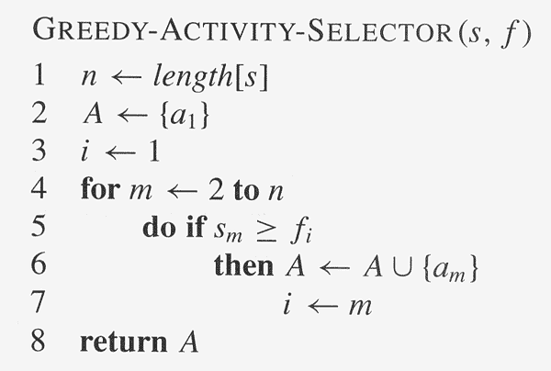
Activity selection Algorithm

Slide 33
Exercise
Input: A list of different activities with starting and ending times.
{(5,9), (1,2), (3,4), (0,6), (5,7), (8,9)}
Use greedy algorithm to do maximum number of activities.

Slide 34
At least it’s fast
Running time:
O(n) if the activities are already sorted by finish time.
Otherwise, O(nlog(n)) if you have to sort them first.

Slide 35
What makes it greedy?
At each step in the algorithm, make a choice.
Hey, I can increase my activity set by one,
And leave lots of room for future choices,
Let’s do that and hope for the best!!!
Hope that at the end of the day, this results in a globally optimal solution.

Slide 36
Sub-problem graph view
Greedy algorithms:
Big problem
Not only is there optimal sub-structure:
optimal solutions to a problem are made up from optimal solutions of sub-problems
but each problem depends on only one sub-problem.
sub-problem
Write a DP version of activity selection (where you fill in a table)! [See hidden slides in the .pptx file for one way]
sub-sub-problem
Ollie the Over-achieving Ostrich

Slide 37
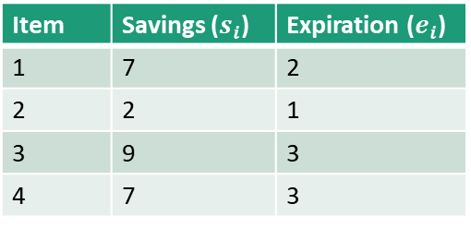
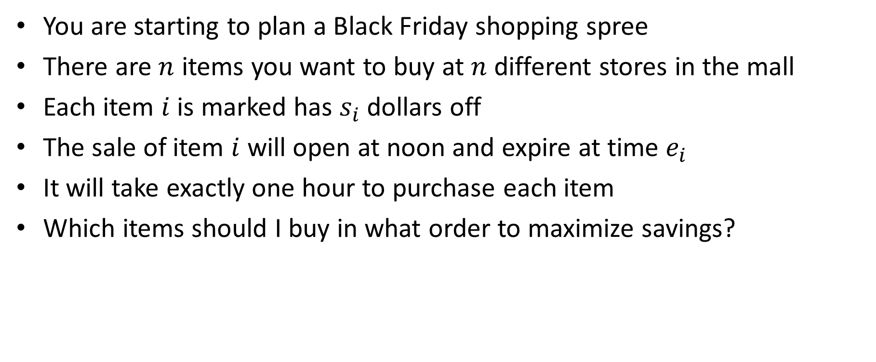
Task Scheduling
You are starting to plan a Black Friday shopping spree
There are $n$ items you want to buy at $n$ different stores in the mall
Each item $i$ is marked has $s_{i}$ dollars off
The sale of item $i$ will open at noon and expire at time $e_{i}$
It will take exactly one hour to purchase each item
Which items should I buy in what order to maximize savings?
Item | Savings ($s_{i}$) | Expiration ($e_{i}$)
1 | 7 | 2
2 | 2 | 1
3 | 9 | 3
4 | 7 | 3
Noon
2pm
1pm
Savings:
7+7+9=23
Item 1
Item 2
Item 3
Item 4

Slide 38
Scheduling with deadlines
We have n jobs to execute, each of which takes unit time.
Job i earns us a profit p_{i}, if it finished no later than time d_{i}.
Find a schedule that will gives us the maximum profit.
Example:
 | 1 | 2 | 3 | 4 | 5
profit | 30 | 10 | 36 | 25 | 16
deadline | 4 | 2 | 3 | 2 | 3
Schedule 1, 2, 3 gives us a profit of 76.
Schedule 5, 4, 3, 1 gives us an optimum profit of 107.

Slide 39
Greedy Scheduling
Greedy instinct:
To maximize the profit, handle jobs with larger profit first.
To finish more jobs, when schedule a job, delay the job as late as possible.
Example: Schedule according to the order of profit, we have a schedule of 3, 1, 4 which has a profit of 91.
Schedule 5, 4, 3, 1 has a better profit of 107.
Task id | 1 | 2 | 3 | 4 | 5
profit | 30 | 10 | 36 | 25 | 16
deadline | 4 | 2 | 3 | 2 | 3

Slide 40

Task id | 1 | 2 | 3 | 4 | 5
profit | 30 | 10 | 36 | 25 | 16
deadline | 4 | 2 | 3 | 2 | 3
Sort
Task id | 3 | 1 | 4 | 5 | 2
profit | 36 | 30 | 25 | 16 | 10
deadline | 3 | 4 | 2 | 3 | 2
Time | 1 | 2 | 3 | 4 | 5
Task id
4
3
5
1
36 + 30 + 25 + 16 + 0 = 107

